Slide 1

‘A Brief History of Time’
Stephen Hawking
Hermann Käbi
Tallinn Secondary School of Science
2021

Slide 2
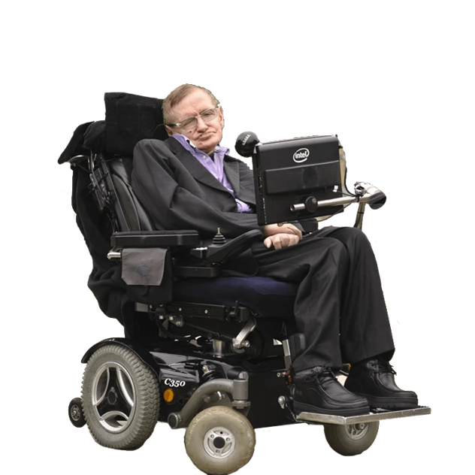

About the author
Dr Stephen William Hawking (1942-2018)
Englist astrophysicist, theoretical scientist and author
Black holes, Hawking radiation, information paradox
Fundamental Physics Prize in 2013
A Brief History of Time (1988), The Universe in a Nutshell (2001)
The Theory of Everything (2014)
Notes:
8 January 1942 – 14 March 2018

Slide 3
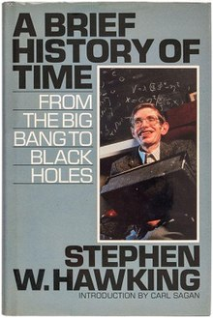
A Brief History of Time
Published in 1988
Written for the general public

Slide 4
Changing the world

